Slide 1
GENDER
(IN)
EQUALITY
Project Members:
Arfaa Shaikh
Shristi Roy
Sadia Sayed
Ruheen Fatima Qureshi

Slide 2
AN INTRODUCTION
Rightly did Swami Vivekanand say, 'Just as a bird can not fly with one wing only, a Nation can not march forward if the women are left behind’.
Men and women are the two holes of a perfect whole. Strength is borne of their union their separation results in weakness. Each has what the other does not have. Each completes the other and is completed by the other.

Slide 3
DATA COLLECTION
STEP 1
STEP 3
Made the questionnaire
Collected the responses completely online
STEP 2
FINAL STEP
Conducted the Pilot Survey
Collected a total of 505 of responses

Slide 4
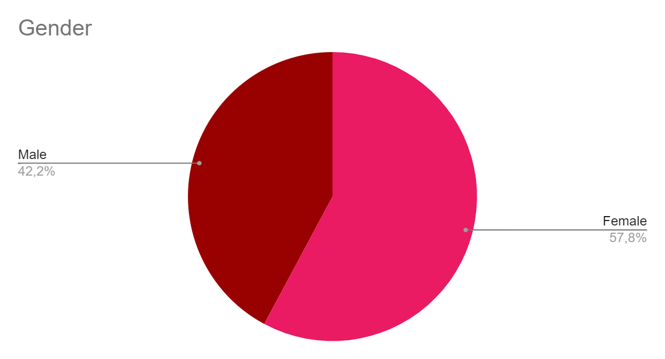
GRAPHICAL ANALYSIS

Slide 5
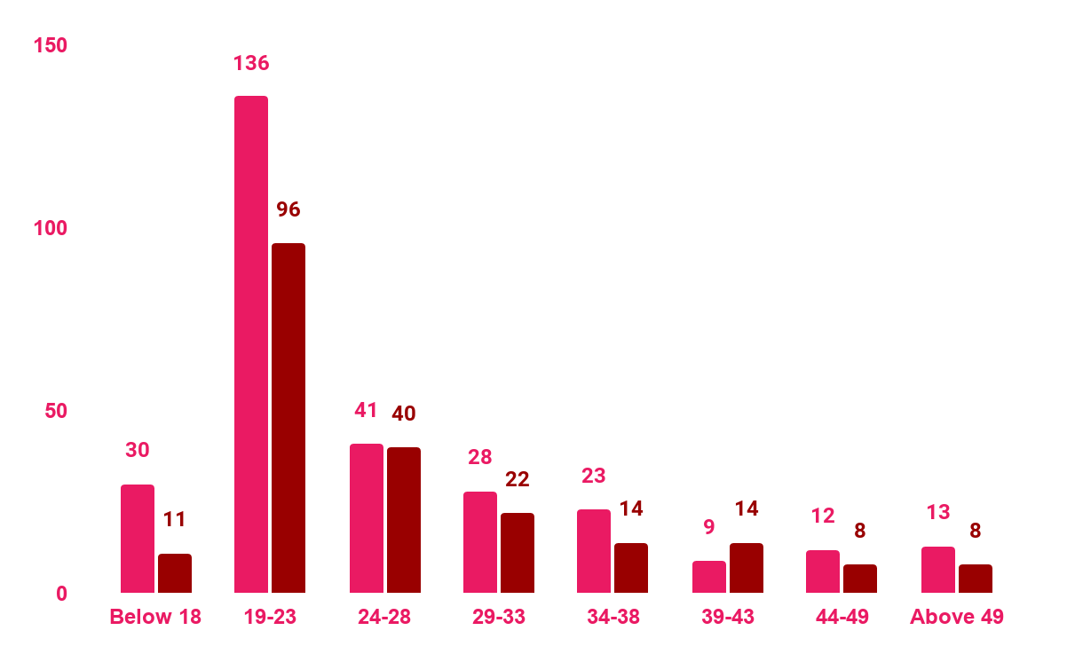
Gender In AGE
FEMALE
Majority of females are in the age group 19-23
MALE
Majority of Males are in the age group 19-23

Slide 6
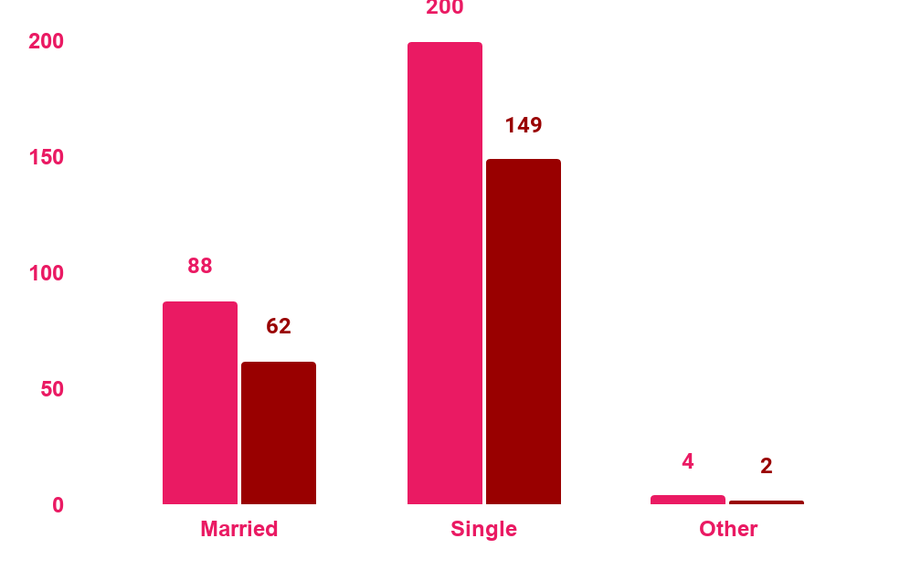
Present Marital STATUS
FEMALE
Majority of females are Single
MALE
Majority of males are Single

Slide 7
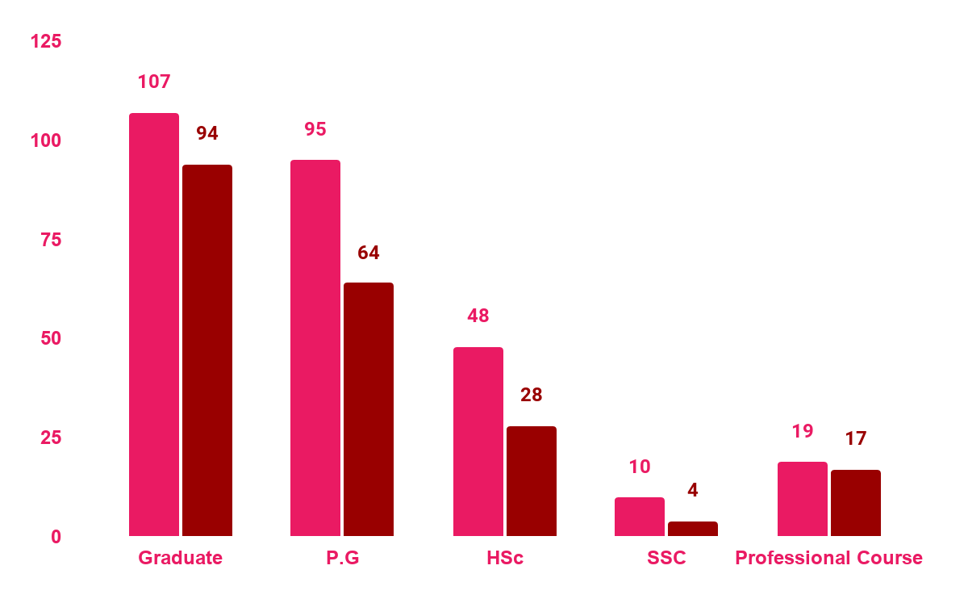
GENDER in EDUCATION
FEMALE
Females have a higher rate in education
MALE
Majority of the males are graduated

Slide 8
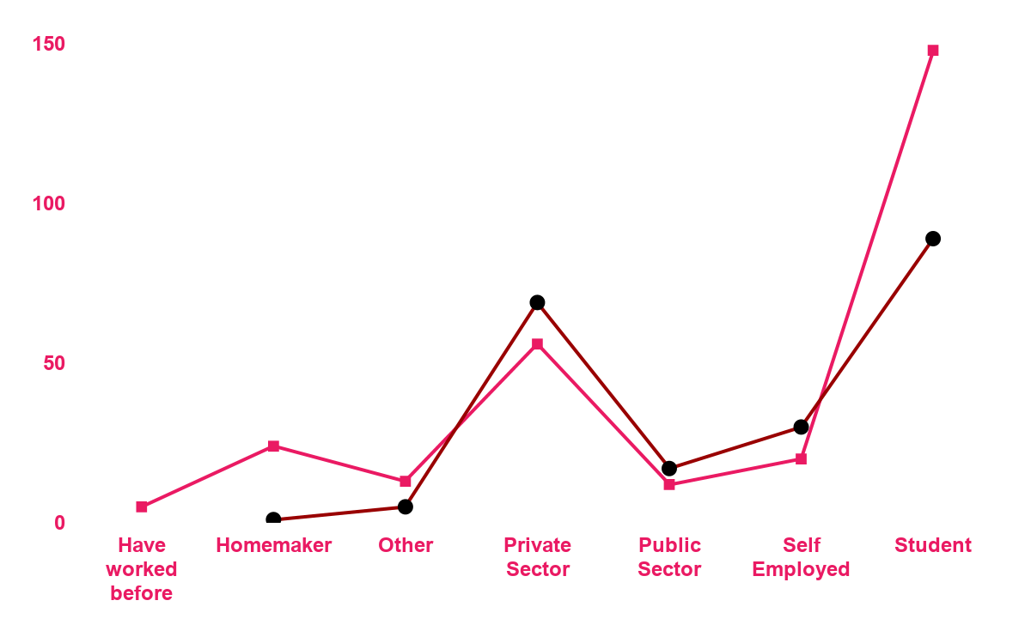
GENDER in OCCUPATION
FEMALE
Though proportion of females in education is more, we see less participation of women in workforce.
MALE

Slide 9
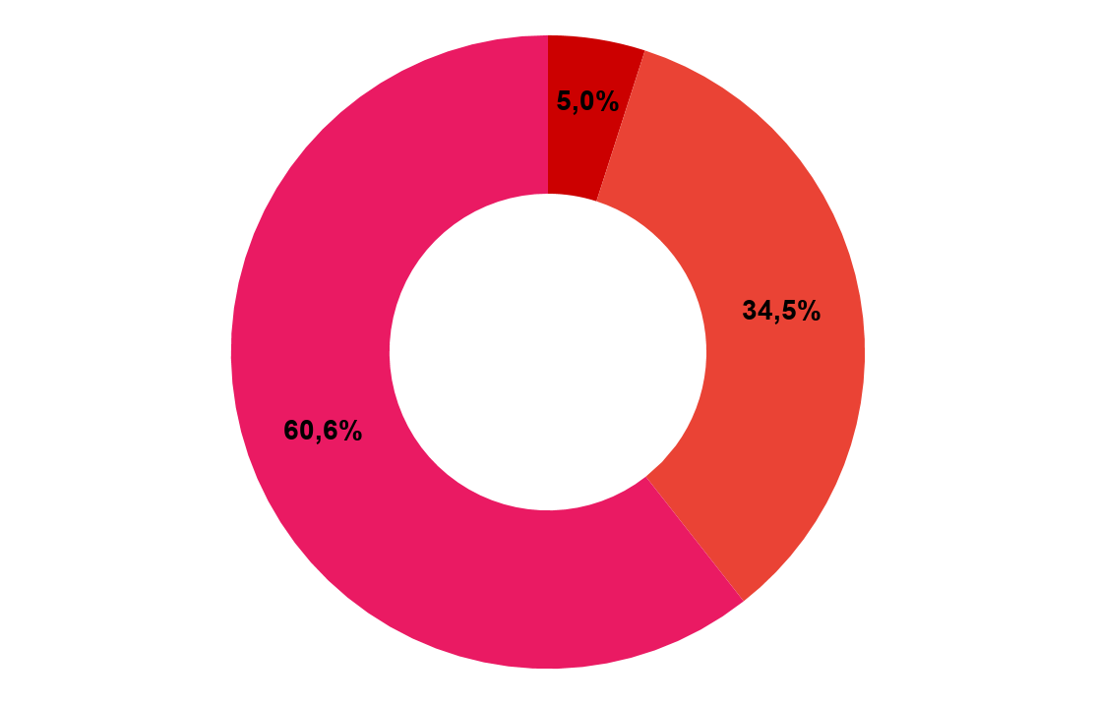
FAMILY TYPE
NUCLEAR FAMILY
Majority of the respondents lives in a Nuclear family
JOINT FAMILY
ALONE

Slide 10
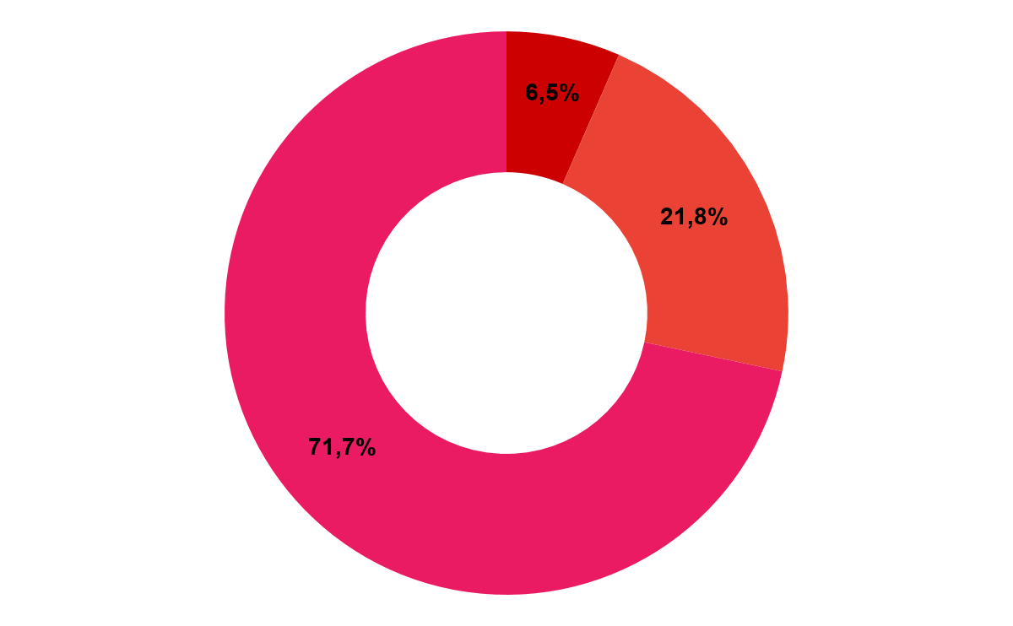
AREA TYPE
URBAN AREA
SEMI URBAN
RURAL

Slide 11
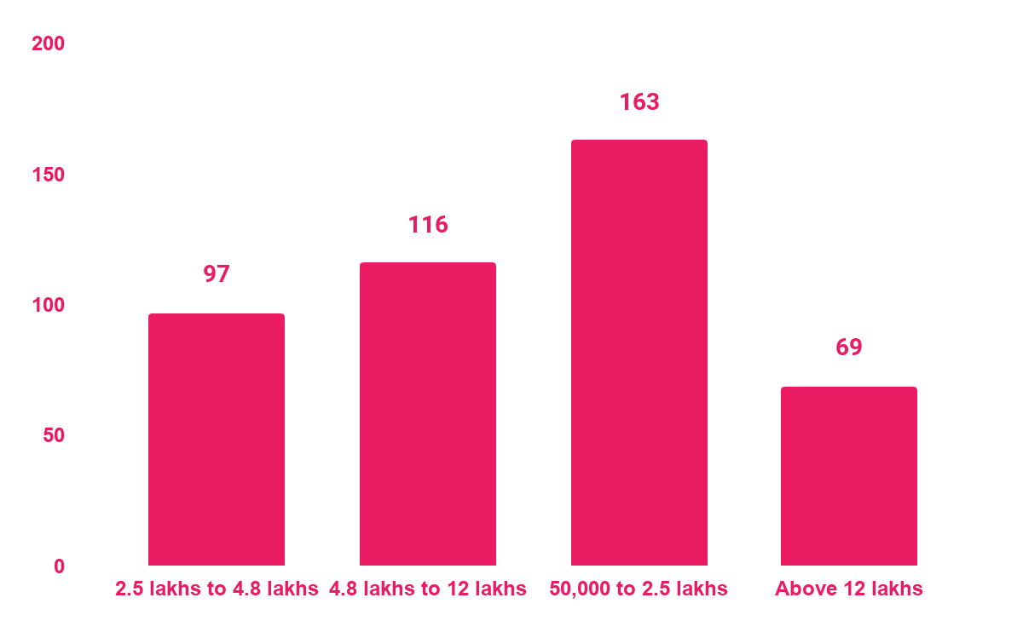
FAMILY INCOME

Slide 12
01
PARETO ANALYSIS
To find reasons leading to Gender Inequality.

Slide 13
WHAT IS IT?
It is a technique which illustrates that 80% effect arise from 20% of causes or
The idea is that by doing 20% of work you can generate 80% benefit of ding whole job.
20% of actions will account 80% of results.

Slide 14
WHEN TO USE PARETO ANALYSIS
THEORY 1
THEORY 2
THEORY 3
THEORY 4
Used when we have many problems or project’s and we want to focus on the most significant ones.
Helps prioritize the improvement opportunities that bring the most values to the business.
Allows to reach a consensus about what needs to be addressed first.
Used during improvement of projects to focus on the causes that contributes most to a particular effect.

Slide 15
REASONS THAT CAN BE CAUSES OF GENDER INEQUALITY:
ILLITERACY
RELIGION
PATRIARCHY
POVERTY
INFLUENCE OF SOCIETY
CULTURE
MALE SELF INTEREST
GENDER NORMS
STATUS
KNOWLEDGE
SOCIETY
TRADITION
WISDOM

Slide 16
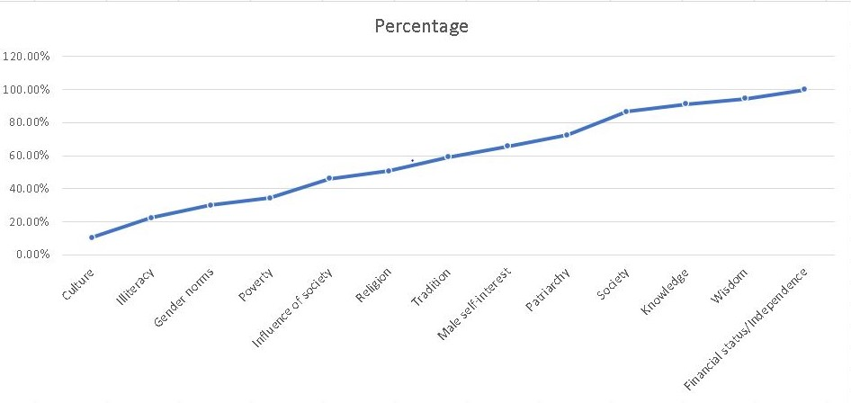
PARETO CHART FOR PARETO FREQUENCY

Slide 17
FROM PARETO ANALYSIS, WE CAN SEE THAT THE REASONS THAT CAN BE THE CAUSES OF GENDER INEQUALITY ARE:
From Pareto analysis we conclude the main reasons leading to gender inequality are:
SOCIETY
KNOWLEDGE
WISDOM
FINANCIAL STATUS/INDEPENDENCE

Slide 18
02
K-MEANS CLUSTERING
To classify the respondents who has experienced or encountered Gender Inequality at the workplace.

Slide 19
What is it?
K-means clustering is a clustering method that subdivides a single cluster or a collection of data points into K different clusters or groups.
The algorithm analyzes the data to find organically similar data points and assigns each point to a cluster that consists of points with similar characteristics
Each cluster can then be used to label the data into different classes based on the characteristics of the data

Slide 20
STEPS INVOLVED
Selecting random centroids for each cluster
Adjusting the centroid for the newly formed cluster in step 4
01
02
03
04
05
Repeating step 4 till all the data points are perfectly organised within a cluster space
Assigning each data point to its closest centroid
Selecting an appropriate value for K which is the number of clusters or centroids

Slide 21
Variables Used
Age | Received less support from senior leaders
Gender | Been passed over for most important assignments
Education | Felt isolated at the workplace
Occupation | Been denied a promotion
Earned less than a woman/man | Been turned down for a job
Were treated as if they were not competent | Lost a good opportunity
Experienced repeated small slights at work

Slide 22
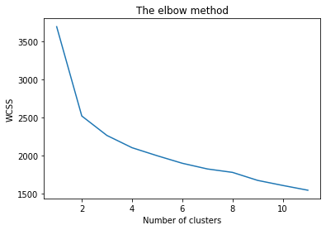
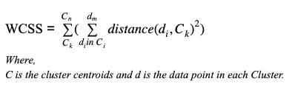
Choosing the right number of clusters
WCSS
Elbow Method
We can find the optimum value for K using an Elbow point graph. We randomly initialise the K-Means algorithm for a range of K values and will plot it against the WCSS for each K value.
As the elbow occurred at k = 2, we have made 2 cluster for our analysis.
An ideal way to figure out the right number of clusters would be to calculate the Within-Cluster-Sum-of-Squares (WCSS).
The idea is to minimize the sum.

Slide 23
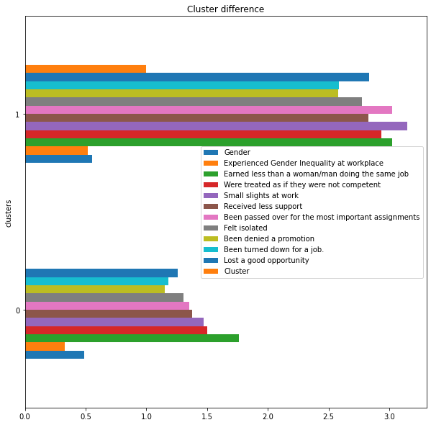
Both clusters are significantly different from each other.
Based on the graphical representation of cluster centroids, it can be seen that,
Cluster_0 : not encountered instances of gender inequality at workplace
Cluster_1 : Encountered instances of gender inequality at workplace.

Slide 24
Conclusion
Cluster_0 :
Not encountered instances of gender inequality at the workplace.
The characteristics observed in this cluster show that the respondents have not experienced gender inequality at the workplace and they have agreed on being paid less than women/men doing the same job.
Cluster_1 :
Encountered instances of gender inequality at the workplace.
In this cluster we observe that most of the respondents have agreed to the reasons which are considered to highlight gender inequality at the workplace. For eg: It is clearly seen that earning less than women/men doing the same job, not being competent enough, being passed over for most important assignments, been turned down for a job and losing good opportunities are the most highlighted factors.

Slide 25
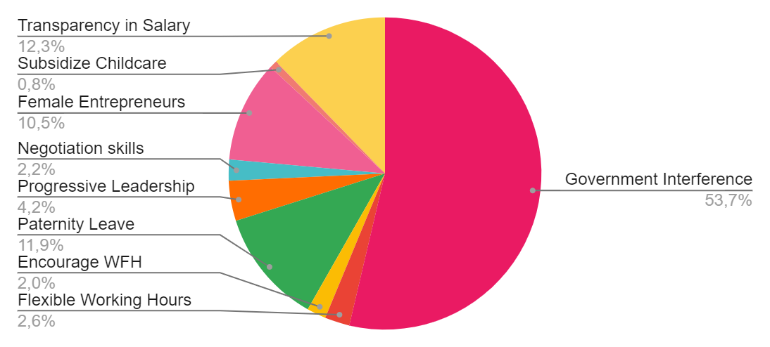
Measures to overcome Gender Pay Gap
From the responses of our respondents we can clearly identify that Government interference can be a solid measure to overcome the Gender Pay Gap in India which is 19% percent at present between both genders.

Slide 26
03
DECISION TREE
To understand the characteristics of respondent who support paternity leave being made mandatory across all sectors

Slide 27
What is it ?
Decision Tree algorithm belongs to the family of supervised learning algorithms.
It can be used for solving regression and classification problems.
Nowadays, Decision Tree algorithm is known by its modern name CART which stands for Classification and Regression Trees.
The term was introduced by Leo Breiman.

Slide 28
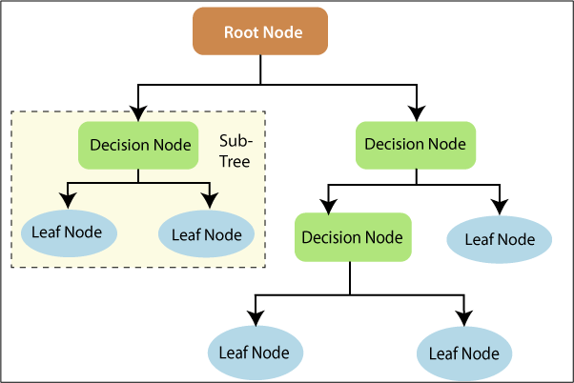
Terminologies Used
Root Node
Decision Nodes
Leaf/ Terminal Node
Branch / Sub-Tree

Slide 29
TREE GROWING METHODS
Gini denotes the purity and hence Gini impurity tells us about the impurity of nodes
It finds out statistical significance between the differences between sub-nodes and parent node
It is a statistical property that measures how well the given attribute separates training example to target classification
This algorithm used standard formula of variance to determine best split
01
GINI IMPURITY
CHI SQUARE
03
02
INFORMATION GAIN
REDUCTION IN VARIANCE
04

Slide 30
Easy to understand
Useful in data exploration
Advantages of Decision Tree
Less data cleaning required
Data type is not a constraint
Non parametric model

Slide 31
How are we using it ?
We put out a question “Do you think paternity leave should be made mandatory across all sectors?”
We collected responses to the question as Yes/No
We have used the Decision Tree to classify responses based on demographics

Slide 32
Variables Used
Age
Type of family
Number of earning members
Gender
Number of family members
Education
Marital status
Income
Occupation
Area
Paternal Leave

Slide 33
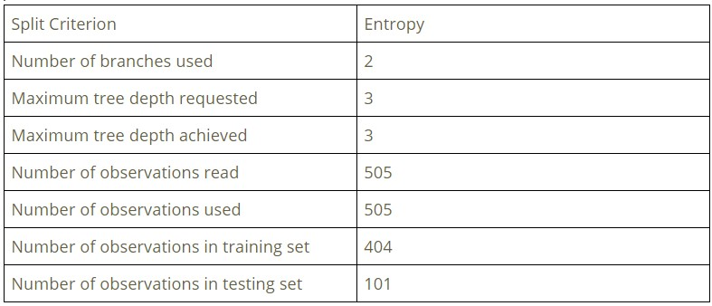
Demographics Used:
Age
Occupation
Family Members

Slide 34
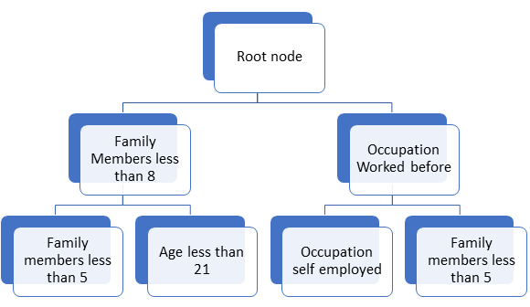

Slide 35
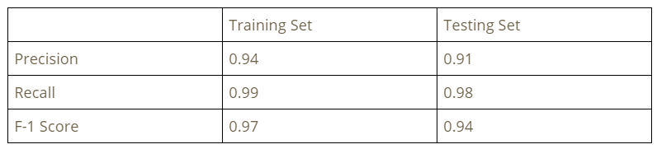
Classification Report

Slide 36
Interpretations
A person with family members less than 8 support paternal leave being made mandatory across all sectors.
A person with family members less than 8 and age less than 21 does not support paternity leave being made mandatory across all sectors.
A person with occupation who has worked before does not support paternity leave being made mandatory across all sectors.
A person with occupation worked before and self employed supports paternity leave being made mandatory across all sectors.
A person with occupation worked before and has family members less than 5 does not support paternity leave being made mandatory across all sectors.

Slide 37
04
RANDOM FOREST
To study Gender Disparities based on roles performed by both men and women

Slide 38
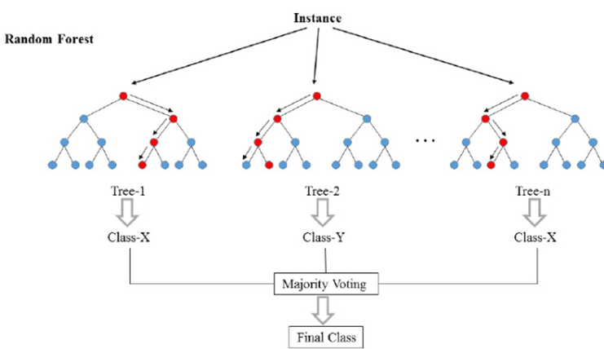
What is Random Forest?
Random forest is a supervised learning algorithm. The "forest" it builds, is an ensemble of decision trees, usually trained with the “bagging” method.
The general idea of the bagging method is that a combination of learning models increases the overall result.

Slide 39
Variables Used
General Details
Family Details
Role of taking responsiblity
Domestic Chores
Age, Education, Occupation, Relationship etc
No.of Family members,No. of earning members,
Area you reside
Household chores, Financial responsibility,
Looked after you
Prepare food, Shop for groceries,’Laundry and Cleaning tasks

Slide 40
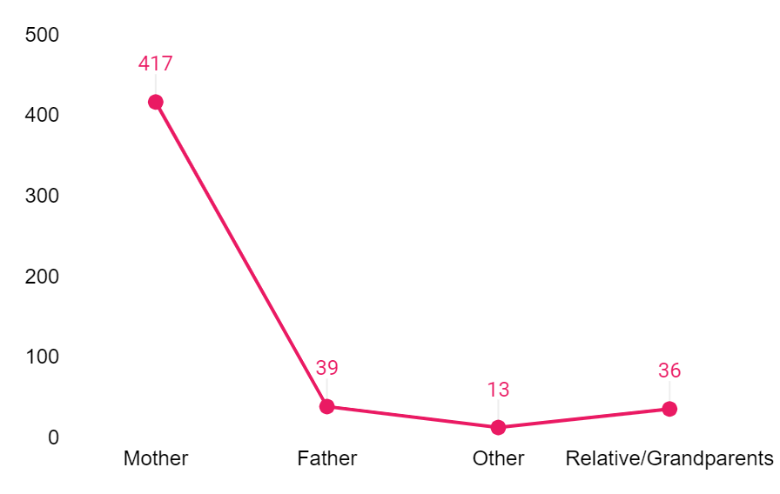
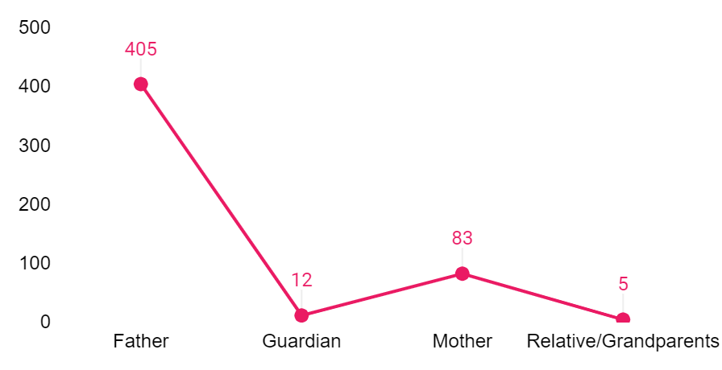
Responsible for Upbringing
Responsible for Financial needs

Slide 41
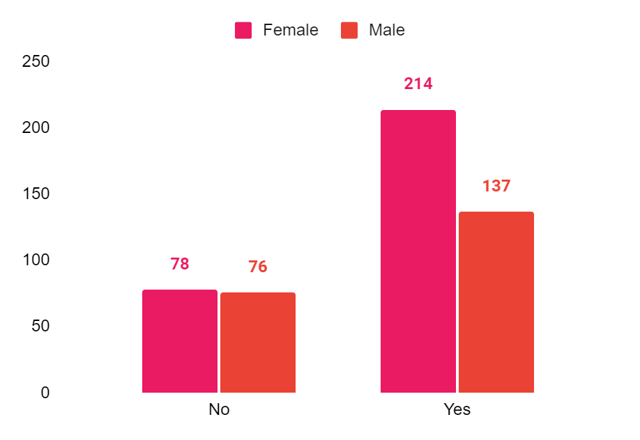
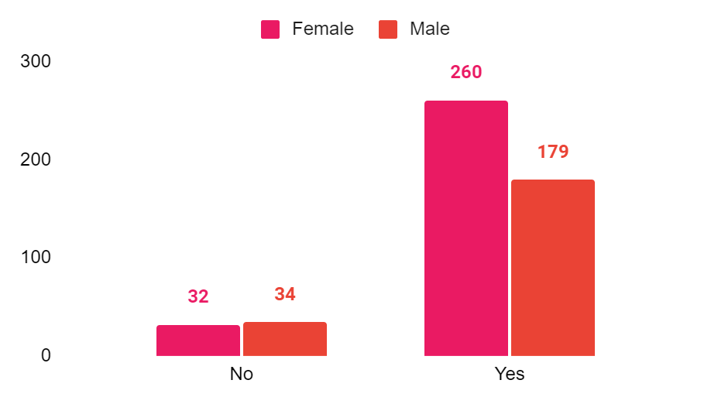
Prepare Food Cleaning and Laundry

Slide 42
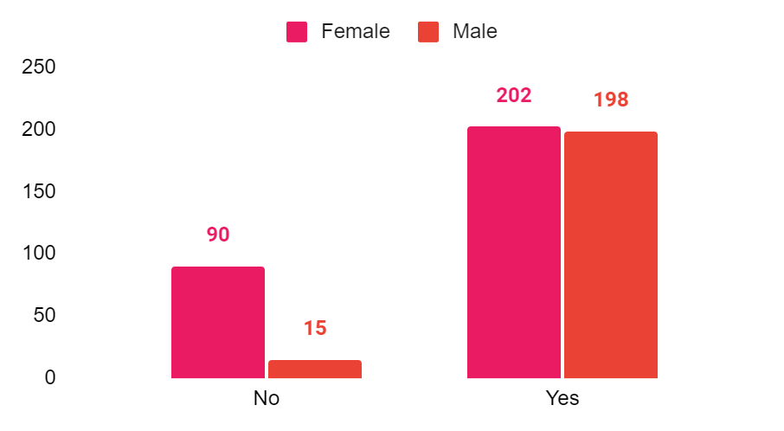
Shop for Groceries

Slide 43
Feature Importance
Great quality of the random forest algorithm is that it is very easy to measure the relative importance of each feature on the prediction.
Feature's importance determine at how much the tree nodes that use that feature reduce impurity across all trees in the forest.
Important features in our modes are this ;
Age | 0.1632
Number of family members | 0.0981
Occupation | 0.0975
Qualification | 0.0852

Slide 44
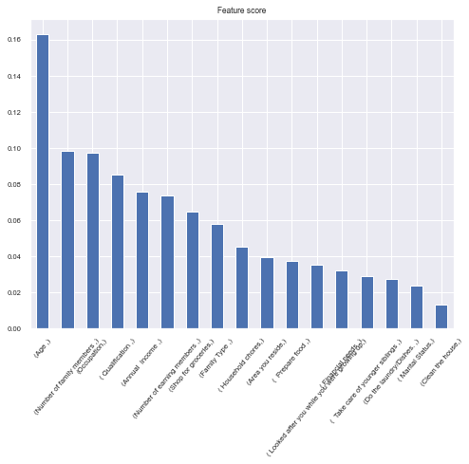

Slide 45
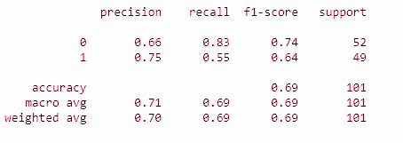
Conclusions
Confusion matrix
From the classification of our model,
We got 69% overall accuracy on our test set
The precision for men and women are also fairly good for this model
The f1- score is 0.74 which is closer to 1

Slide 46
05
ASSOCIATION RULES
To study the position of men and women concerning social representation & participation.

Slide 47
01
02
03
04
05
06
There are IF-THEN statements that help to shoe the probability of relationships between data items within large datasets in various types of databases
It helps us to identify frequent patterns or casual structures from datasets that are highly associated with each other
Association rules mining finds interesting associations are relationships among large sets of data items.
An association rule has two parts: antecedent(if) snd consequent(then)
Walmart, DMArt, BigBazar, Amazon, etc use association rules to analyse customer behaviour
We have used Apriori algorithm.

Slide 48
THE 3 MAJOR CONCEPTS OF ASSOCIATION RULES
SUPPORT
01
It is an indication of how frequently an item appears in the dataset
CONFIDENCE
02
It shows how frequent will the rue-head occur among all the groups containing the rule-body.
LIFT
03
It shows the strength of association between the rule head and rule body

Slide 49
VARIABLES USED:
We have asked the respondents to multiple select from the below variables:
Patriarchy
Wisdom
Society
Knowledge
Financial status

Slide 50
EXAMPLE
TID 1 | APPLE, BEER, RICE,MEAT
TID 2 | APPLE, BEER, RICE
TID 3 | APPLE, BEER
TID 4 | APPLE, PEAR
TID 5 | MILK, BEER, RICE, MEAT
TID 6 | MILK, BEER, RICE
TID 7 | MILK, BEER
TID 8 | MILK, PEAR

Slide 51
Consider an association rule as follows for the following table,
{apple} => beer
For the above rule support, confidence, and lift is as follows;
Support = 4/8 = 0.5
Confidence = support{apple,beer}/support{apple} = 0.75
Lift = 1.5

Slide 52
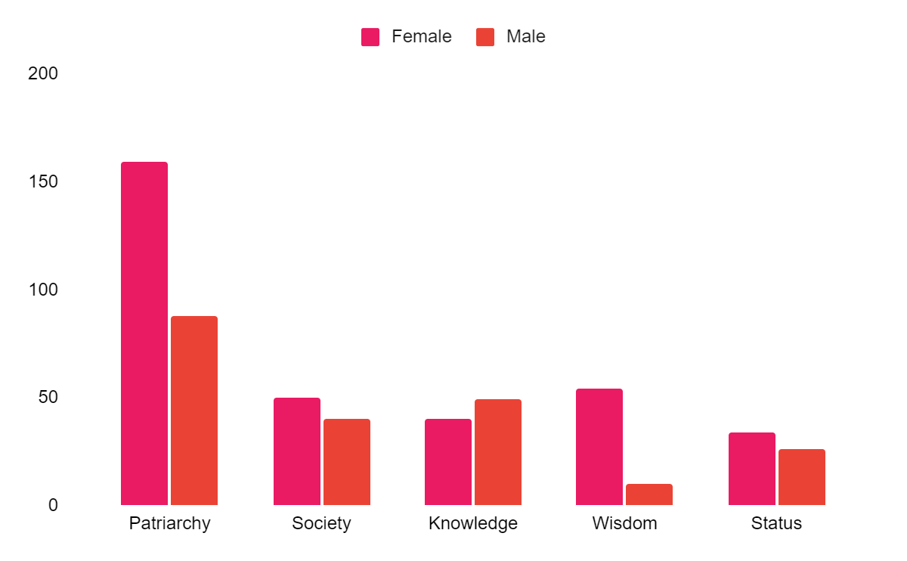
GRAPHICAL REPRESENTATION OF POSITIONS OF MEN WITHIN FAMILIES DETERMINED BY BOTH GENDER

Slide 53
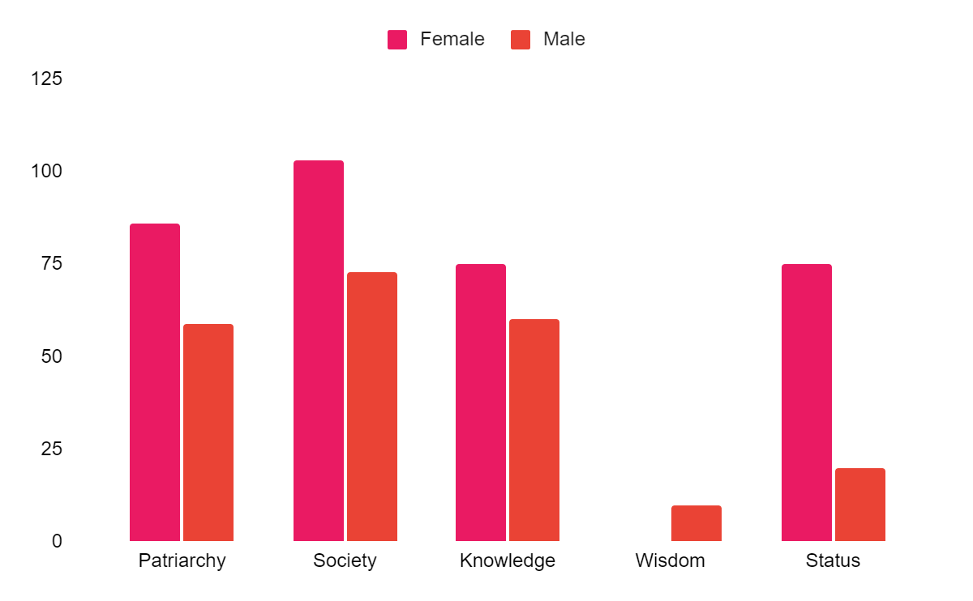
GRAPHICAL REPRESENTATION OF POSITIONS OF WOMEN WITHIN FAMILIES DETERMINED BY BOTH GENDER

Slide 54
TABLE FOR RULES
Following table shows the rules created on the basis of the positions of the men in Society.
Antecedents
Consequents
Support
Confidence
Lift
Female
Patriarchy
0.314851
0.643725
1.113291
Society
Female
0.099010
0.544521
1.096080
Financial status
Male
0.051485
0.43333
1.027387
Society
Male
0.174257
0.44444
1.05370
Knowledge
Male
0.079208
0.550562
1.305333

Slide 55
On similar line, following table shows the rules created on the basis of the positions of Women in Society.
Antecedents
Consequents
Support
Confidence
Lift
Female
Patriarchy
0.203960
0.352740
1.09959
Status
Female
0.051485
0.565217
1.096080
Male
Society
0.144554
0.342723
1.088523
Society
Male
0.144554
0.459119
1.088523
Knowledge
Male
0.11813
0.44444
1.053730

Slide 56
For MEN
Female
Patriarchy
Male
Financial status
Society
Knowledge
For WOMEN
Female
Patriarchy
Financial status
Male
Society
Knowledge

Slide 57
06
K-MODES CLUSTERING
To analyse people’s opinion about misuse of laws

Slide 58
“Men are also a victim of domestic violence and social injustice, But state institutions and society in general takes such violence less serious because of the prevailing attitude towards men, such belief that men are fearless sustain greater .”
- Research

Slide 59
K-Modes Clustering is modified version of the standard k-means clustering process optimized to cluster categorical data. It does so by using simple matching dissimilarity measure also referred to as the Hamming Distance.
Hamming Distance
As the data used in k modes are categorical, we can’t calculate the Euclidian distance. So, what we are left with is dissimilarity measure also known as hamming distance.
K- Modes Clustering

Slide 60
Dissimilarity measure works on a simple principle;
D(xi, yj) = 0 if xi = yj i= 1,2,.....k and j= 1,2.....n (sample size)
= 1 if xi is not equal to yj
where, xi is the value of attribute corresponding to ith cluster and yj isthe value of the same attribute corresponding to jth observation

Slide 61
Steps in K-Modes Clustering
01
The first step when clustering a categorical data set into k clusters using k-modes is to transform the categorical values into numerical values or dummy binary variables.
02
The next step is to randomly select k different objects out of the data set as the initial cluster centroids.
03
Thirdly, we have to calculate the distance between each object and centroid and assign each object to the cluster containing its closest centroid.
04
Lastly, we select the new mode of each cluster centroid and compare it with the previous one. If the two modes differ, we repeat the last two steps. Otherwise, that value of k is fixed.

Slide 62
Based on this , for k=2 modal values turned out to be exact same as that of cluster centroids.
Cluster 0: People who are aware and believe in misuse of laws
Cluster 1: People who are not aware and do not believe in misuse of laws
Age Group | Gender | Qualification | Marital Status | Family Type | Clusters
20-30 | Female | P.G | Single | Nuclear Family | Aware and Believe
20-30 | Male | P.G | Single | Joint Family | Not Aware and do not believe

Slide 63
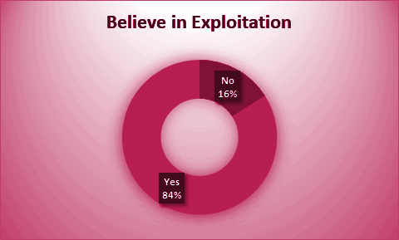

Slide 64
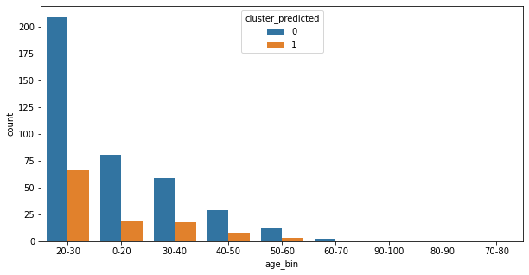
Age
Calculating the Modes

Slide 65
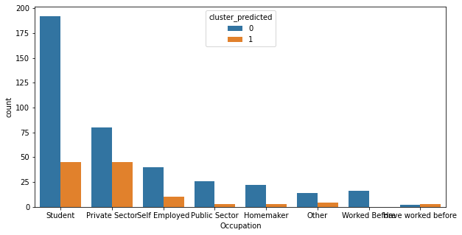
Occupation

Slide 66
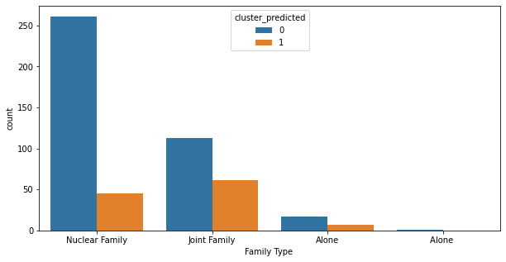
Family Type

Slide 67
According to our research people from Age Group 20-30 are more likely to be aware and also believe in misuse of laws as compared to people from higher Age Group
The proportion of awareness is very higher in students and working professionals as compared to population who are homemakers and this can be reason why there is biasness and inequality in our law system
People belonging to Nuclear Family are more likely to be aware as compared to those who are from joint family
Conclusion

Slide 68
07
ODDS RATIO
To see study the impact of Covid-19 on Gender Inequality

Slide 69
What is it ?
An Odds Ratio is measure of association between a certain property A and a second property B.
As long as you have two properties you think are linked, you can calculate the odds.
It can be used for only 2x2 table for categorical variable.
It is ratio of two odds.

Slide 70
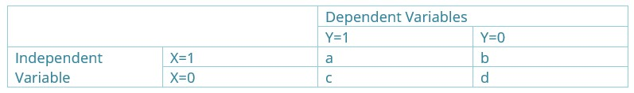
How to Calculate Odds
Create the 2x2 contingency table
Odds ratio = (a/c)/(b/d)
It can be interpreted as how much more likely or unlikely it is for the outcome variable to represent among those with X=1 than among those with X=0

Slide 71
Interpretation of Odds
Odds Ratio = 1, no association between independent and dependent variable
Odds Ratio > 1, positive association between dependent and independent variable.
Odds Ratio < 1, negative association between independent and dependent variable

Slide 72
Variables Used
Gender
Gender Inequality during the Pandemic
Work
Studies
Cooking
Cleaning
Gaming
Reading
Hobbies
Self-Relaxation
Childcare
Sleep

Slide 73
Interpretation of Odds Ratio
Gender Inequality is 1.73 times more likely to be observed during the pandemic.
For males, working hours are 1.11 times more likely to increase than females during the pandemic.
For females, study hours are 0.64 times less likely to increase than males during the pandemic.
For females, the cooking hours are 1.56 times more likely to increase than males during the pandemic.
For females, the cleaning hours are 1.98 times more likely to increase than males during the pandemic.

Slide 74
For males, the gaming hours are 1.68 times more likely to increase than females during the pandemic.
For females, the reading hours are 0.96 times less likely to increase than males during the pandemic.
For females, the time for hobbies are 0.92 times less likely to increase than males during the pandemic.
For females, the self-relaxation hours are 0.66 times less likely to increase than males during the pandemic.
For females, the time spent on childcare is 1.14 times more likely to increase than males during the pandemic.
For females, the sleeping hours are 0.68 times less likely to increase than males during the pandemic.

Slide 75
08
TEXT CLASSIFIER
To study the people’s opinion and views on “Influence of Media on gender Inequality”.

Slide 76
Sentiment Analysis
It is a branch of Natural language processing.
It is used to analyze peoples opinions and to categorize whether a given opinion is Positive, Negative or Neutral.
It can be used to analyze voice as well as text.
Eg:
To analyze tweets on twitter or any other social media
Reviews of a food/delicacies for better decisio. Making

Slide 77
HOW TO GO About?
Data preprocessing:
As part of the preprocessing phase following is done
All the words in corpora (dataset) converted to lowercase
Numbers are removed
Punctuation is removed
English stopwords are removed
White space is removed
Note: English stopwords are words like be, an, about, there, etc. Stop words are the words which do not add much meaning to the sentence.

Slide 78
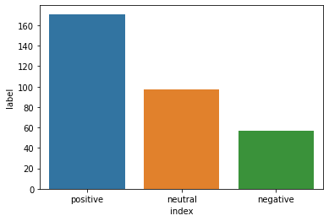
This graph shows the count of different opinions expressed by people on “Influence of Media on Gender Inequality”. Majority of them had positive opinion that media does influence gender inequality in a negative way.

Slide 79
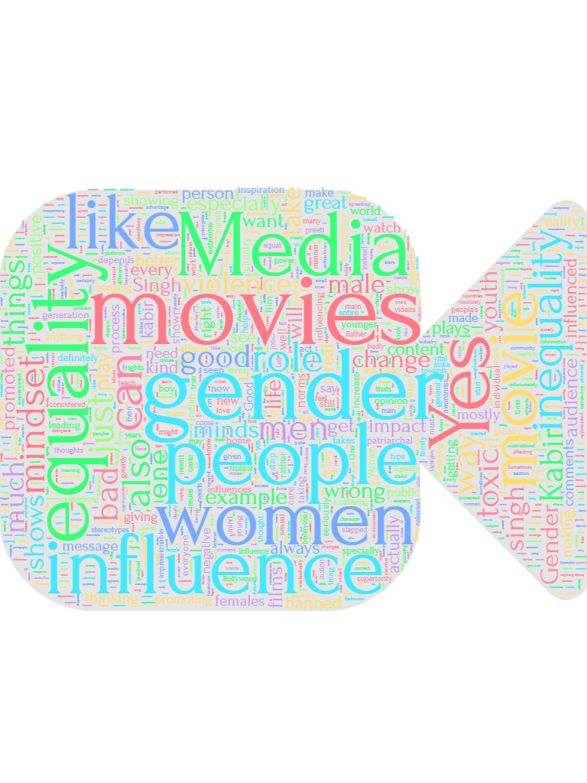
WORDCLOUD
From the masked cloud we can understand the most expressed words are: MEDIA, MOVIES, GENDER, INFLUENCE, INEQUALITY, MINDSET, YOUTH and WOMEN.
1. The media tends to demean men in caring or domestic roles, or those who oppose violence. Such portrayals can influence perceptions in terms of what society may expect from men and women, but also what they may expect from themselves. They promote an unbalanced vision of the roles of women and men in society.
2. young age, children are influenced by the gendered stereotypes that media present to them.
3. Women are frequently portrayed in stereotypical and hyper-sexualised roles in advertising and the film industry, which has long-term social consequences.
4. We strongly believe in the transformative role media can play in achieving gender equality in societies. By creating gender-sensitive and gender-transformative content and breaking gender stereotypes.

Slide 80
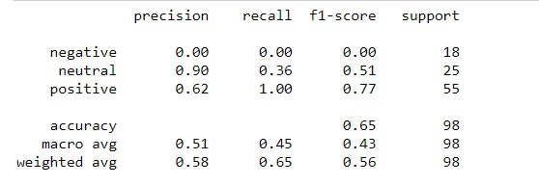
Training the Naïve Bayes Model
We have divided the data in 80:20 ratio, of which 80% is train data and 20% is test data.
Classification Report::
Conclusion: The above built is a text classifier model which helps to predict probability of each word from a particular review and in turn knowing the probability of that particular review belonging to each of the three classes positive, negative and neutral. The review will belong to that particular class for which the probability is higher. This can be used to know the positive and negative review of people on the influence of media on Gender Inequality and Gender Equality.

Slide 81
09
FACTOR ANALYSIS
To study factors promoting Gender Equality
TO those accustomed to privilege, equality feels like oppression.

Slide 82
WHAT IS IT?
WHY DO WE NEED IT?
EXAMPLE
We use factor analysis to represent the data into manageable chunks which are more understandable so as to use it for further analysis.
It is a technique to find underlying relationships among a large number of variables and thus reduce the dimension of the data
L’Oreal’ Shampoo advertisement focusing on reasons for hair fall was based on Factor Analysis Study

Slide 83
TYPES OF FACTOR ANALYSIS
EXPLORATORY
CONFIRMATORY
Used to identify complex interrelationships among items and groups that are similar to each other
Complex approach that tests the hypothesis that the items are associated with specific factors

Slide 84
VARIABLES USED IN FACTOR ANALYSIS
01
02
03
04
Share the household chores.
Encourage both parents to consider parental leave
Avoiding preference to gender for certain job roles
Exercise your political rights.
05
06
07
08
Respect the choices of others.
Awareness needed to promote Gender Equality.
Gender Equality an important aspect in development of society.
Foster/ Encourage an environment where boys and men feel safe expressing their emotions.

Slide 85
VARIABLES USED IN FACTOR ANALYSIS
09
10
11
12
13
Everyone benefits from Gender Equality.
Prevents violence.
Equality implies community safer and healthier.
Efforts to achieve gender equality benefits everyone.
Equal opportunities
14
15
16
17
18
Good for economy
Human Right
Trustworthy and progressive society.
Independence
Women entrepreneur/ empowerment

Slide 86
STEPS TO PERFORM FACTOR ANALYSIS
Verify Assumptions
KMO and Bartlett’s test
Extract Factors
Used PCA method
Construct Elbow Plot
To verify the number of components and factor
Factor Rotation
Used Varimax rotations to better interpretation of the factors and their loadings

Slide 87
Hypothesis for BARTLETT’S TEST OF SPHERICITY
The Kaiser-Meyer-Olkin measure of sampling adequacy tests whether the partial correlations among variables are small.
Bartlett's test of Sphericity tests whether the correlation matrix is an identity matrix
H_{o}: Correlation matrix is an identity matrix. Vs
H₁: Correlation matrix is not an identity matrix.
Decision Criterion:
Reject H_{o} if p-value is less than 0.05.

Slide 88
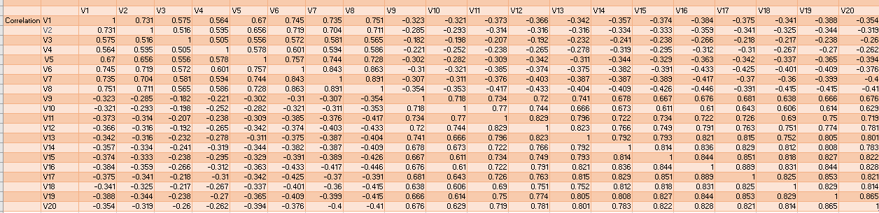
Correlation Matrix
Notes:
I will include table and conclusions of KMO and Bartlett here

Slide 89
Kaiser Meyer Olkin and Bartlett’s Test
KMO Measure of sampling adequacy | .959
Bartlett’s Test of Spherificity Chi-Square | 11419.748
Degrees of Freedom | 190
Sig. | .00
Since KM0 value is >0.5 our sample is adequate for Factor Analysis
Since p-value is less than 0.05 we reject H0 and conclude that variables are correlated

Slide 90
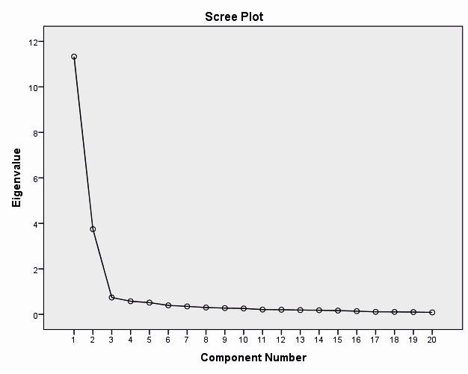
ELBOW PLOT
So the Scree Plot forms the elbow at 2
So the number of factors extracted should be 2

Slide 91
 | Variable | FACTOR 1 | FACTOR 2
V1 | Trustworthy and Progressive Society | .894
V2 | Human Rights | .888
V3 | Equal contribution in decision making | .885
V4 | Women entrepreneur/ empowerment | .876
V5 | Good for Economy | .873
V6 | Benefits everyone | .873
V7 | Independence | 844
V9 | Awareness is needed |  | .880
V10 | Respect choice of others |  | .880
V11 | Sharing the household |  | .829
V12 | Encourage environment where everyone can express their emotions |  | .824
V13 | Encourage both parents to consider parental leave |  | 817
V15 | Avoiding preference for certain role |  | .723

Slide 92
EXTRACTED FACTOR
Factors Extracted
Society
Domestic Level

Slide 93
Summary
Using Pareto Analysis we got to know that main reasons for Gender Inequality are Society, Knowledge , Wisdom & Financial Status. By curbing these reason we can definitely hope for a better tomorrow.
Using K-means clustering we studied gender inequality at the workplace and how people can be distributed in different clusters.
Using Decision trees we got to know who exactly in our research support paternity leave being made mandatory in all sectors.
Using Random Forest and A-Priori algorithm we studied disparities in both genders and what determines Men’s and Women’s role in society and their participation.
Using K-Modes clustering we got to know who among our respondents are aware about misuse of laws , mainly about laws which are biased against men and which leads to inequality.
Odds Ratio helped us to study how Covid-19 is impacting the inequality between both genders. Who are more likely to overwork , experience lack of sleep, spend more time cooking.
Using Sentiment and Text Classifier we analyzed opinions of people about how media influences inequality.
Using Factor Analysis we also got 2 factors viz Society and Domestic Levels which can help us work on how to promote equality.

Slide 94

Thank You

